Slide 1
T-Shirt
Market
Analysis
By Nizar Fathurohman

Slide 2
TABLE OF CONTENTS
01
02
03
04
05
Problem Background
Goal & Objective
Web Scraping
Data Analysis
Insight

Slide 3
Problem Background
Business owner want to launch t-shirt product in a ecommerce but doesn’t have knowledge about t-shirt market condition.
Lacks data resources.

Slide 4
Goals & Objective
Goal
Obective
Provide price range and expected product sold of t-shirt
Scrape t-shirt data from ecommerce
Generate insight

Slide 5
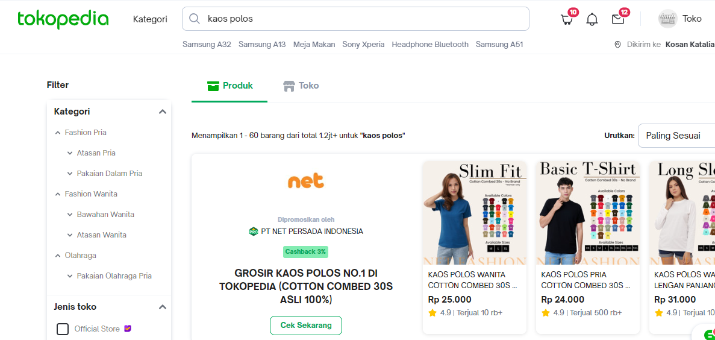
Web Scraping
Data sources are from an ecommerce Tokopedia

Slide 6


Web Scraping
Tools
For scraping data from dynamic website we will use Selenium and Beautifulsoup library to extract the data

Slide 7
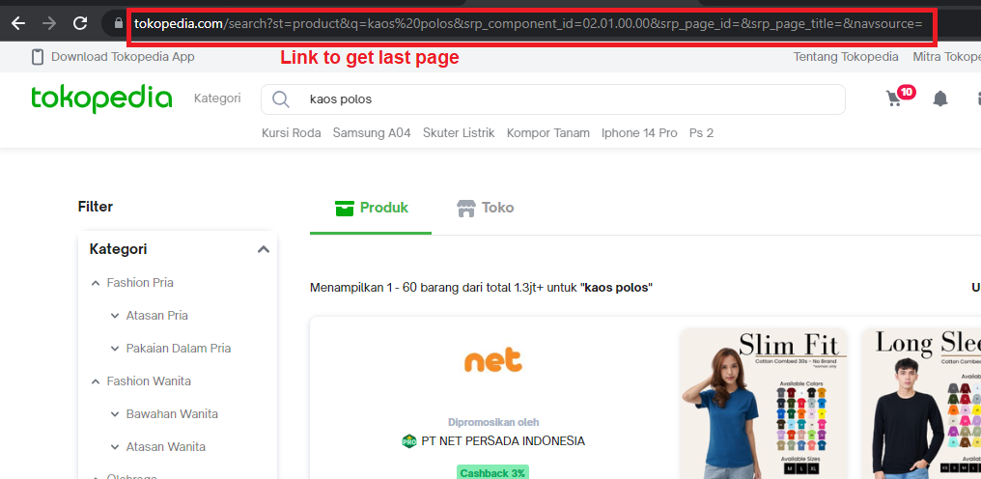
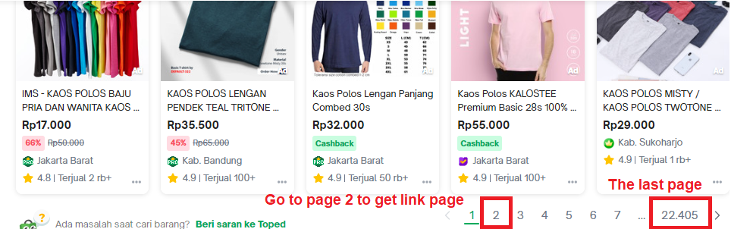
Web Scraping
Process
Starting point
Search result page
The first step we get search result url to get numbers of available page.

Slide 8
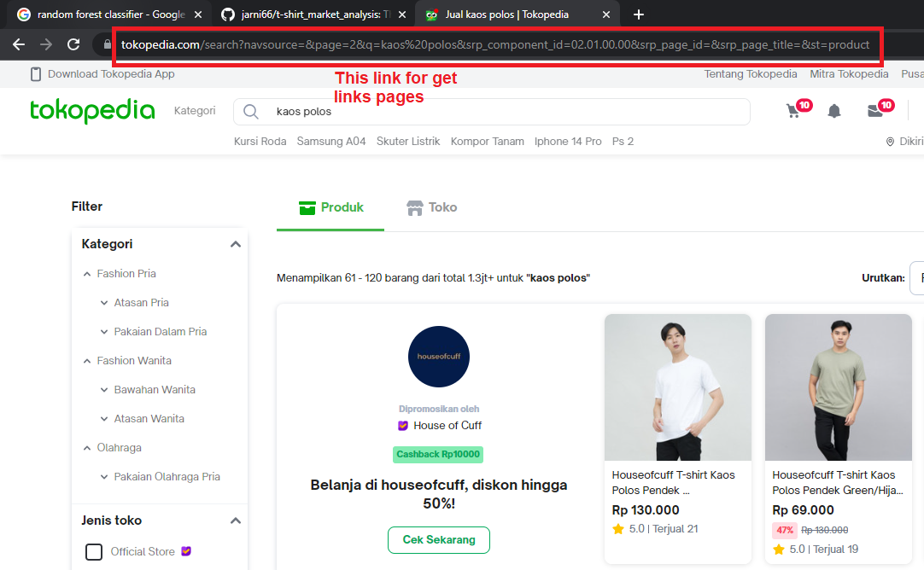
Web Scraping
Process
Go to page 2 to get page url, this is used to get url for each page

Slide 9
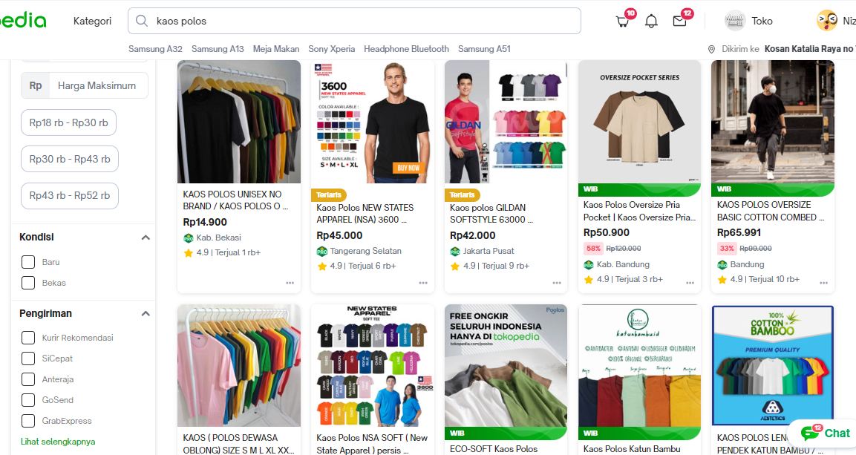
Web Scraping
Process
For each page we get link to specific product

Slide 10
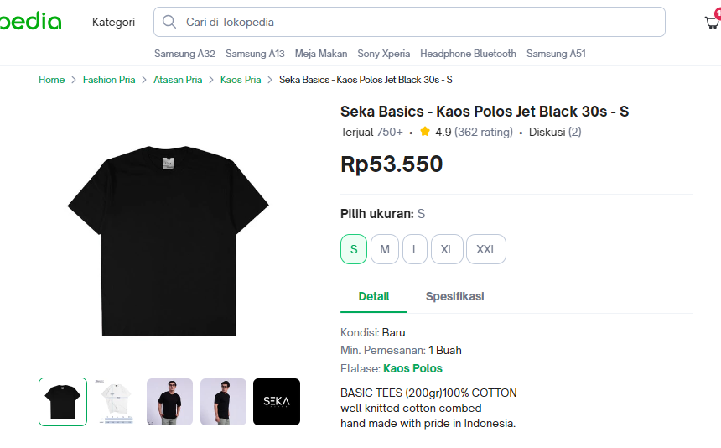
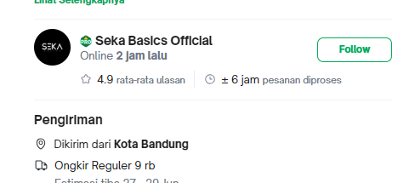
Web Scraping
Process
In product page we scrape relevant data.
name
shop_name
sold
n_discussion
price
rating
n_rating
shop_location

Slide 11
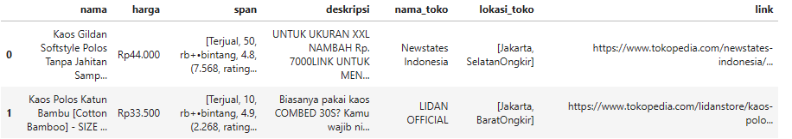
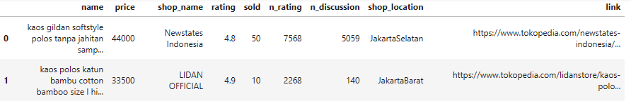
Web Scraping
Result
Raw data
Clean data

Slide 12

Data Analysis
Data sources are from an ecommerce Tokopedia

Slide 13
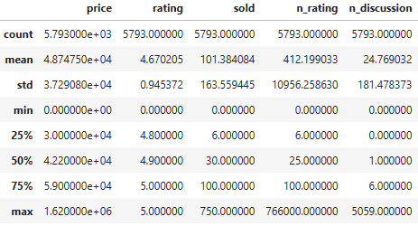
Data Analysis
Descriptive
DATASET SIZE
9 COLUMNS
5793 ROWS
NULL VALUES
0 data
DUPLICATE VALUES
Odd values
0 data

Slide 14
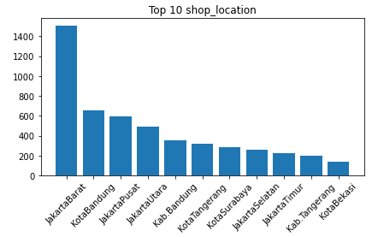
Data Analysis
Univariate
Most of shop located in Jabodetabek, Bandung and Surabaya

Slide 15
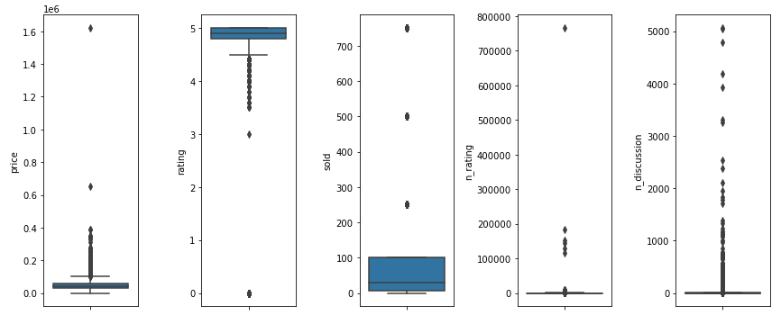
Data Analysis
Univariate
price column have small distribution which having focused price
Odd value in price column
mostly product having 3.5 - 5 rating
product sold are distribute around 100 pcs.
number of sold are rounded in value 250, 500 and 750.
in n_rating and n_discussion columns having high variance values.

Slide 16
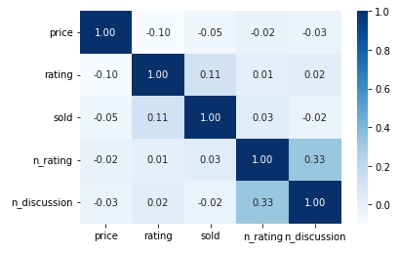
Data Analysis
Multivariate
There is some small correlation in sold and rating, and n_discussion and n_rating.

Slide 17
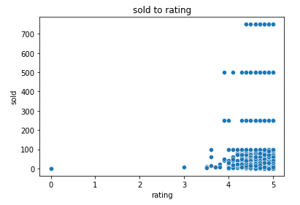
Data Analysis
Multivariate
Numbers of sold product increase significant when rating more than 3.5.
Numbers of sold more than 100 are rounded to hundred, this because resources issue that round the values.

Slide 18
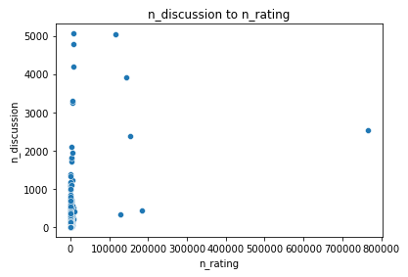
Data Analysis
Multivariate
Higher discussion mostly happend in low n_rating

Slide 19
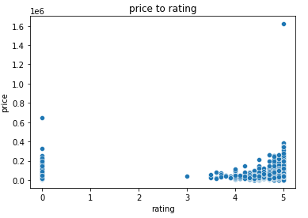
Data Analysis
Multivariate
There is some correlation in rating to price

Slide 20
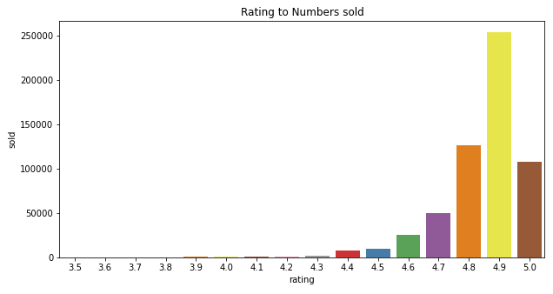
Data Analysis
Multivariate
The high number product were sold are in rating range >= 4.6.

Slide 21
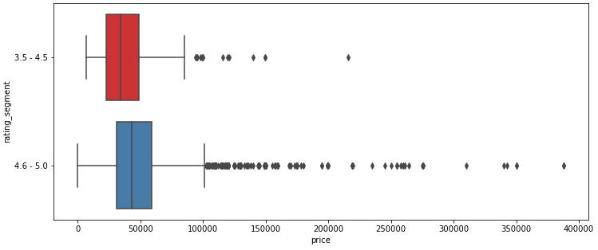
Data Analysis
Multivariate
There is slightly a difference in rating segment on product pricing.

Slide 22
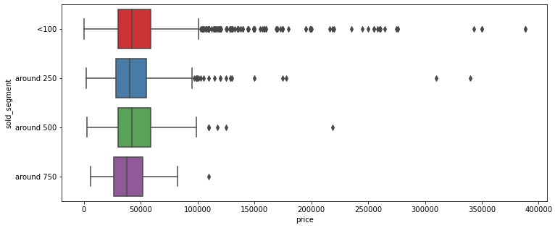
Data Analysis
Multivariate
The lower sold segment having high variety product price.

Slide 23

Insight

Slide 24
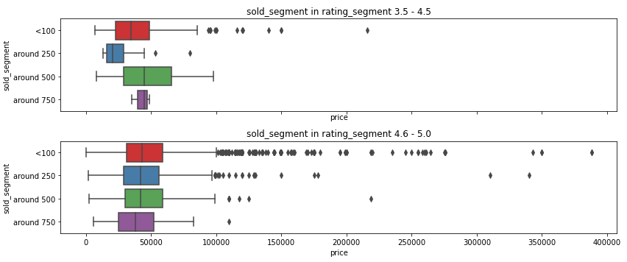
Insight
Although there are another factor that can affect number of sold, rating, and price we can gather some use full insight from chart above.
T-shirt product are focused in rating 4.6 to 5.0 and 3.5 to 4.5.
Product with price more than 100,000 tend to have number of sold under 500
T-shirt market value are in range 30837.5 - 59000.0

